Slide 1
2021/12/24

Slide 2
Overview
DAX component company and Germany specific issue
Historical Return
DAX historical risk-expected return of GMVP, MSRP
Strategy
ME+MOM Strategy building process
Comparison
Compare our strategy with some benchmark strategy
Potential Risk
The implementability and potential risk
Performance
Out of sample return of our strategy

Slide 3
PART 1
Overview

Slide 4
Overview of DAX Index
DAX Index is Value Weighted Index, the share of individual company is limited to 10%.
Numbers of component stocks : 40
Industry composition : 17% Technology, 17% in Raw material, 15% in Financial, 13% in Industrial.
Industry Composition
Main Company
Company | Ticker | Industry | Shares
Linde | LIN.DE | Material | 10.47%
SAP | SAP.DE | Technology | 10.18%
Siemens | SIE.DE | Industrials | 8.65%
Allianz | ALV.DE | Financial | 7.22%
Bayer | BAYN.DE | Healthcare | 5.52%
4

Slide 5
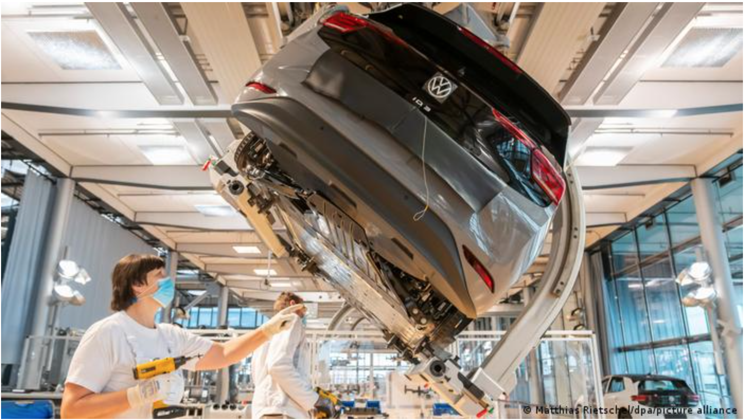

Country specific issue
Global supply chain shortage : Supply chain hold-ups prevent some manufacturers from producing at full capacity. It indeed affected the Germany Industrial and automobile industry.
Covid 19 : Surge in coronavirus infections in Germany affect the consumption demand. In the research, it forecast the consumer index will down 1.6 point in December. It definitely damaged the consumer industry.
Supply chain shortage affect Industrials
Main Company
DW News、Reuters
5

Slide 6
PART 2
Historical Return

Slide 7
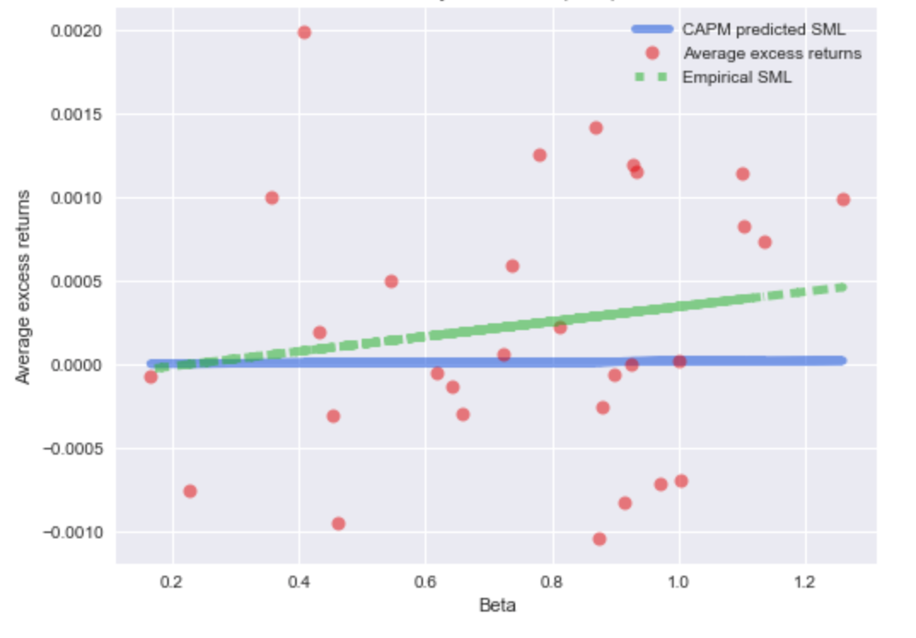
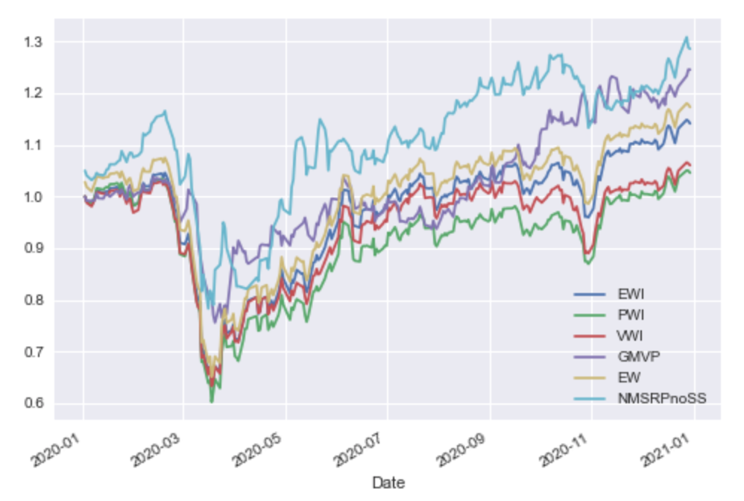
Historical risk-expected return for DAX
NMSRP has the highest return in these portfolio.
Most of portfolios have higher return than Value weighted portfolio which DAX used.
CAPM predicted SML is flatter than Empirical SML because CAPM doesn’t work so well in describing expected return.
Security market line
Historical Return for DAX
?
7

Slide 8
PART 3
Strategy

Slide 9
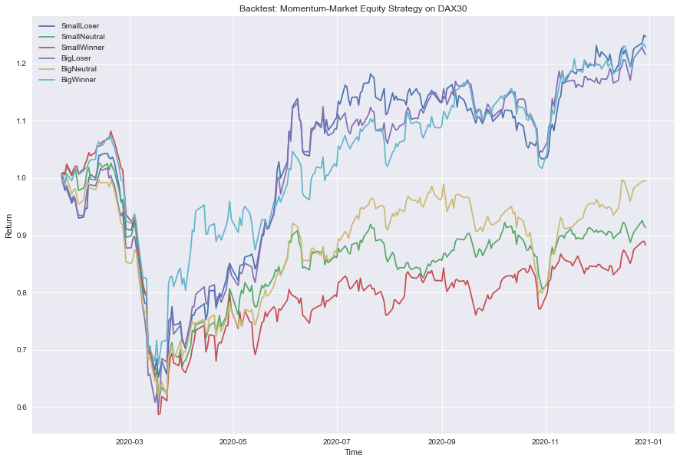
Proprietary strategy
Used the 2 factor model (Market Equity and Momentum)
Backtesting period: 2021.01.01~2020.12.31
Identify each stock to one of the six sectors
LONG the best performing three sector and SHORT the remaining sectors
Factor for our ME+MOM strategy
9

Slide 10
PART 4
Comparison

Slide 11
Comparison
Advantage: lowest volatility
Disadvantage: did not outperform other strategies
Comparison of strategy
Comparison of cumulative return plot
Strategy | Return | Standard Deviation
MoM+ME | 7.8% | 1.8%
PWI | 7.01% | 4.3%
VWI | 10.9% | 5.3%
GMVP | -2.5% | 6.1%
EW | 9.8% | 5.1%
11

Slide 12
PART 5
Potential Risk

Slide 13
Potential Risk of our strategy
Potential Risk :
Momentum can be undependable
Future performance may not be relevant with previous performance.
Strategy’s transaction cost may be high because we need to adjust our strategy frequently.
Implementary :
Our strategy only contains different weight in DAX component, so it is implementary. However, we have short position in our portfolio, it is more difficult to implement our strategy.
13

Slide 14
PART 6
Performance

Slide 15
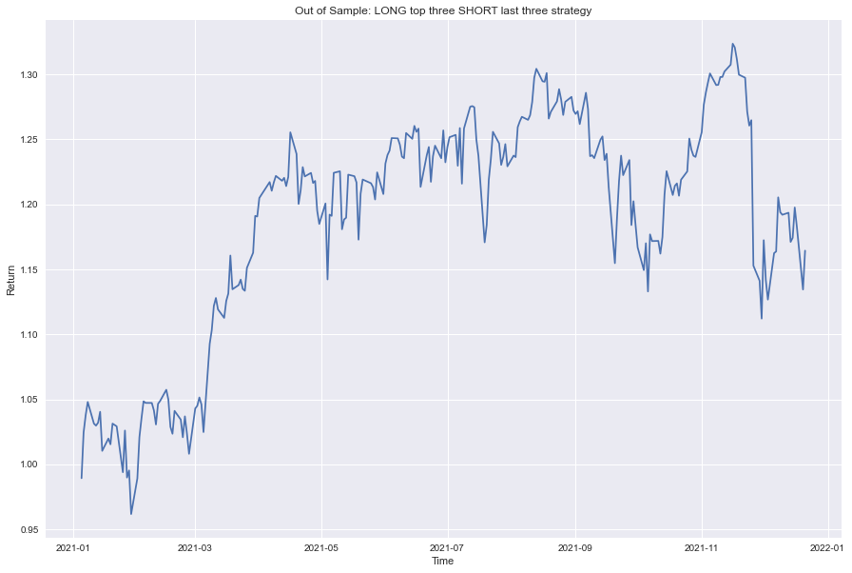
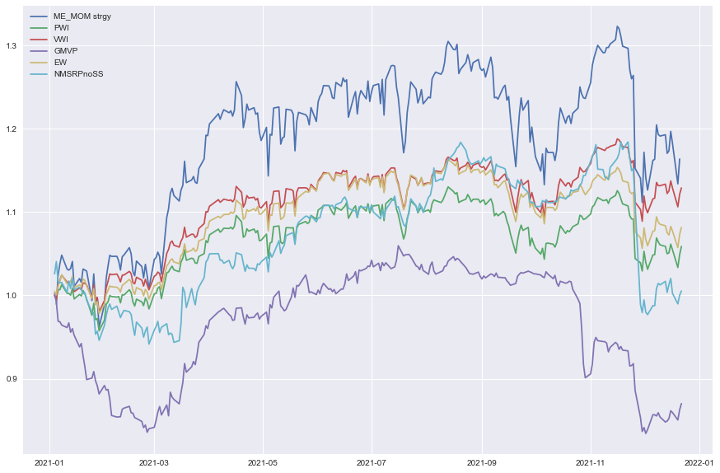
Strategy’s performance
Strategy’s Sharpe Ratio: 4.3%
One Year cumulative return: 16.39%
DAX30 cumulative return: 14.77%
Our strategy performance (out of sample)
Benchmark performance (out of sample)
15

